Slide 1
Exploratory Data Analysis of Large-Scale Industry Performance Dataset
Created by Shivangini

Slide 2
Introduction
Exploratory Data Analysis (EDA) is a statistical approach to understand data before predictive modeling.
It uses summary statistics, visualizations, and relationship analysis to uncover patterns and anomalies.
Project Context:
• Large-scale industry performance dataset covering global companies
• 15,000 company records across 5 industries and 4 countries
• 12 variables including revenue, employees, profit, customers, and ratings
Business Value:
• Identify industry trends and performance benchmarks
• Understand revenue behavior and market dynamics
• Support strategic decision-making and forecasting

Slide 3
Problem Statement & Objectives
Problem Statement:
Analyze a large-scale industry performance dataset using univariate, bivariate,
and multivariate statistical techniques to extract meaningful business insights.
Primary Objectives:
1. Perform comprehensive univariate analysis on all numerical variables
2. Conduct bivariate analysis to study relationships between variable pairs
3. Apply multivariate analysis for multi-factor interaction patterns
4. Detect and interpret outliers using boxplots and IQR method
5. Measure skewness and kurtosis for distribution shape analysis
6. Generate correlation matrix and heatmap for numerical variables
7. Compare performance across industries, countries, and regions

Slide 4
Libraries, Tools & Methodology
Python Libraries Used:
• NumPy — Numerical operations and multidimensional array handling
• Pandas — Data loading, cleaning, manipulation, and statistical analysis
• Matplotlib — Histograms, boxplots, bar charts, and scatter plots
• Seaborn — Advanced statistical visualizations and correlation heatmaps
EDA Methodology Applied:
Step 1: Data Loading & Initial Exploration (head, tail, info, describe)
Step 2: Data Cleaning (null check, duplicate check, date conversion)
Step 3: Univariate Analysis (distributions, skewness, kurtosis, boxplots)
Step 4: Categorical Analysis (frequency counts, grouped comparisons)
Step 5: Bivariate Analysis (scatter plots, correlation coefficients)
Step 6: Multivariate Analysis (correlation heatmap, grouped boxplots)

Slide 5
Data Preprocessing & Quality Assessment
Data Loading:
df = pd.read_csv('INDUSTRY.csv') — Successfully loaded 15,000 records
Data Cleaning Steps:
• Converted created_date column to datetime format using pd.to_datetime()
• Verified all column data types (7 numerical, 4 categorical, 1 datetime)
• Checked for missing values across all 12 columns
• Checked for duplicate records
Quality Check Results:
• Missing Values: 0 null values in all columns — Dataset is 100% complete
• Duplicate Records: 0 duplicates found
• Data Integrity: All records are valid and analysis-ready
• No imputation or row removal was required

Slide 6
Descriptive Statistics — Numerical Variables
Variable Mean Median Std Dev Min Max
employee_count 2,601 2,608 1,440 101 5,099
annual_revenue_million $554.76M $557.10M $288.26M $50.21M $1,049.88M
profit_margin_percent 24.88% 24.88% 11.54% 5.00% 45.00%
customer_count 50,502 50,505 28,837 502 100,484
market_rating 2.51 2.50 1.44 0.00 5.00
Key Observations:
• Average company has ~2,601 employees generating ~$555M annual revenue
• Average profit margin is ~25% with market rating of ~2.5 out of 5
• Average customer base is ~50,500 customers per company
• Companies founded between 1990–2019, centered around year 2004

Slide 7
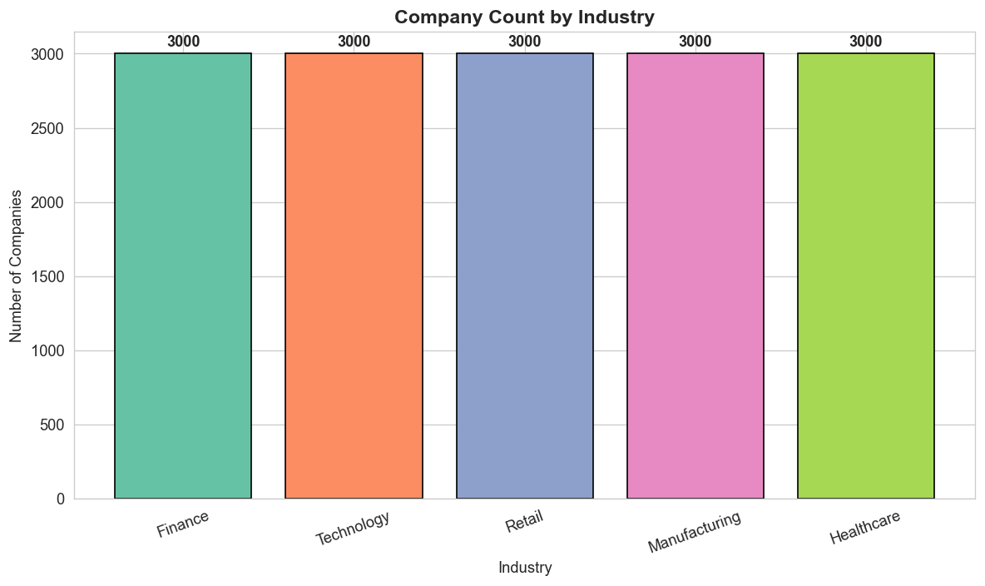
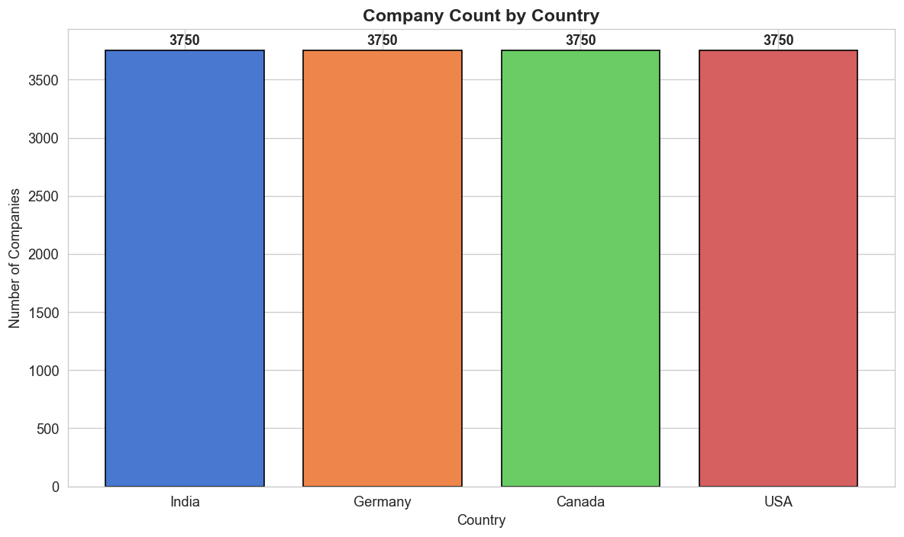
Categorical Distribution — Industry & Country
Industry: 3,000 companies each in Finance, Technology, Retail, Manufacturing, Healthcare — perfectly balanced distribution
Country: 3,750 companies each in India, Germany, Canada, and USA — equal geographic representation

Slide 8
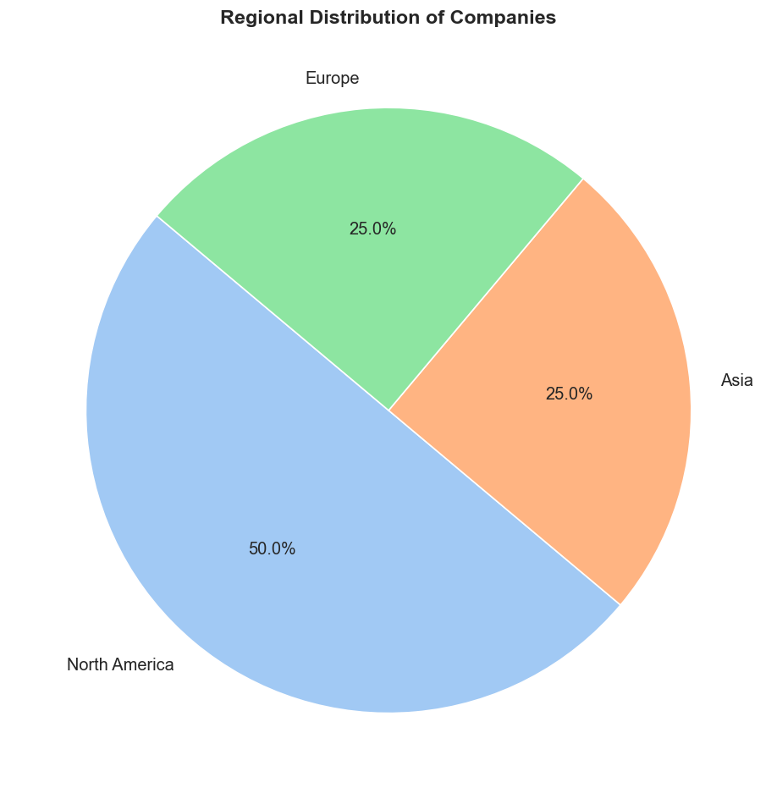
Regional Distribution of Companies
Regional Breakdown:
• North America: 50.0% (7,500 companies)
— Canada + USA combined
• Asia: 25.0% (3,750 companies)
— India-based companies
• Europe: 25.0% (3,750 companies)
— Germany-based companies
Insight:
• North America has the largest share due to
Canada and USA both mapping to this region
• Balanced global representation across
all three major regions

Slide 9
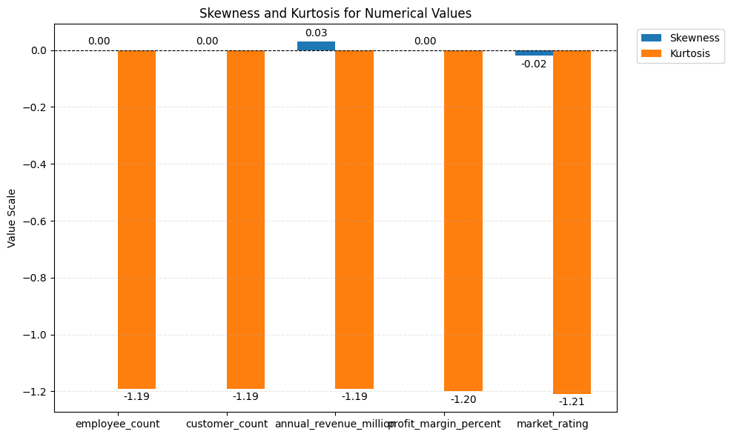
Skewness & Kurtosis Analysis
Skewness Results:
• All values near 0 (range: -0.02 to 0.03)
• Nearly symmetric distributions
• annual_revenue_million : 0.0273
(slight positive)
• market_rating: --0.0200 (slight negative)
Kurtosis Results:
• All values ≈ -1.19 (platykurtic)
• Flatter than normal distribution
• Values spread evenly across ranges
Interpretation: Uniform-like distributions
with no severe skewness or heavy tails

Slide 10
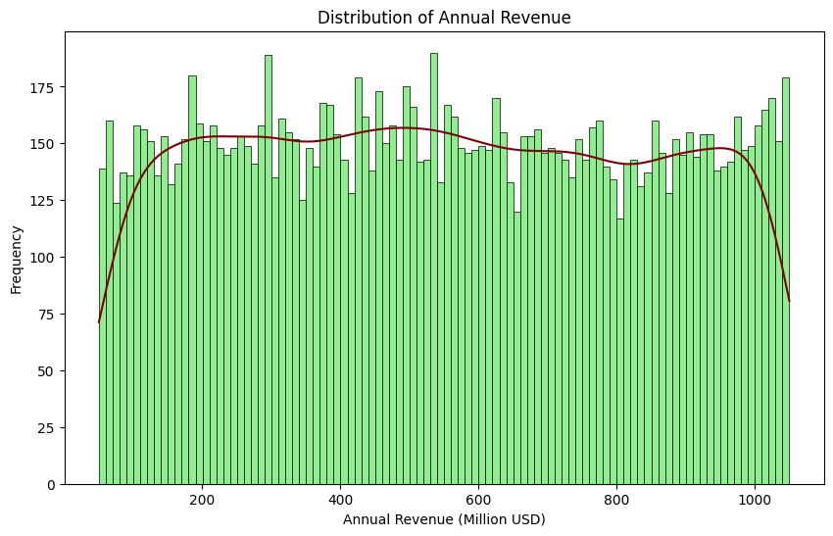
Revenue Distribution — Histogram
Annual Revenue Distribution:
• Range: $50M to $1,050M
• Nearly uniform across all bins
• Each bracket: ~1,400–1,600 companies
• Peak at 450–550M range
Statistical Measures:
• Mean: $549.73M | Median: $543.92M
• Std Dev: 288.24M
• Skewness: 0.03 | Kurtosis: -1.19
Insight: Revenue is evenly distributed.
No single revenue bracket dominates.
Most companies operate at
medium-to-large scale.

Slide 11
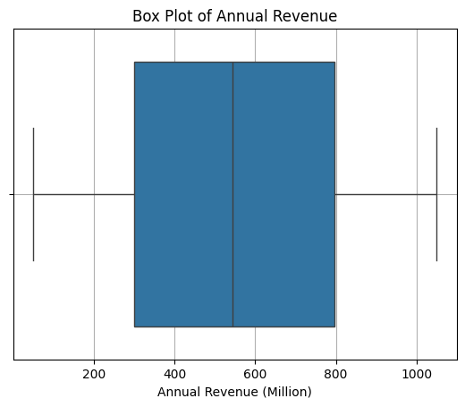
Revenue Outlier Detection — Boxplot
Boxplot Analysis (IQR Method):
• Median revenue: ~$543.92M
• Q1 (25%): ~$306M
• Q3 (75%): ~$803M
• IQR: ~$497M
• Whiskers: $50M to $1,050M
Outlier Findings:
• No extreme outliers beyond whiskers
• All values within expected business range

Slide 12
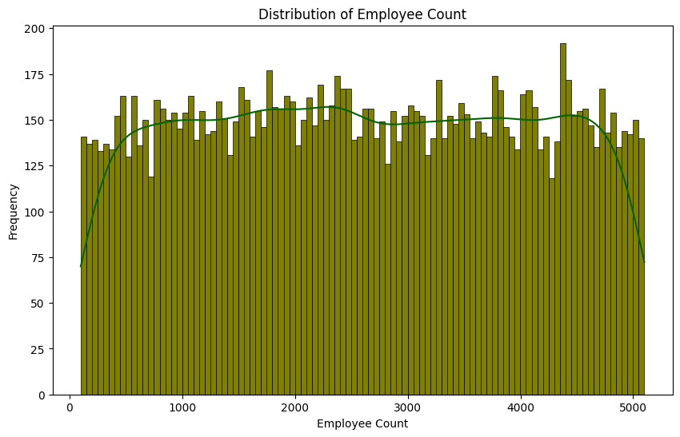
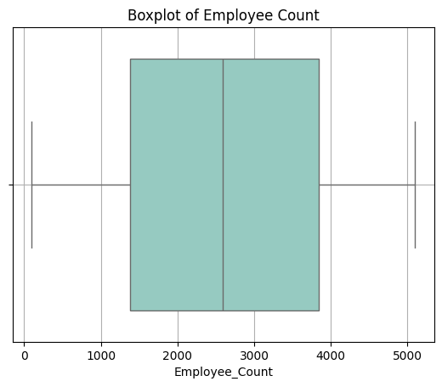
Employee Count Analysis — Distribution & Outliers
Employee Count: Range 101–5,099 | Mean 2,601 | Uniform distribution | Boxplot shows median ~2,608 with no extreme outliers

Slide 13
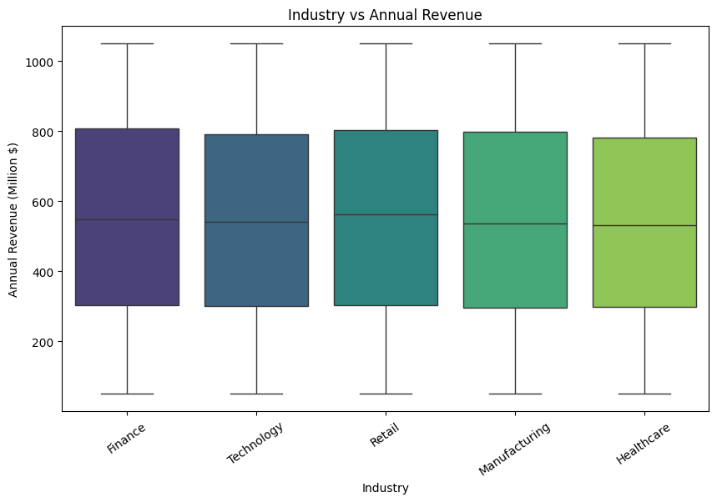
Revenue by Industry — Boxplot
Industry-wise Revenue Comparison:
• Finance: Median ~$549.49M
• Technology: Median ~$541.95M
• Retail: Median ~$562.08M
• Manufacturing: Median ~$536.48M
• Healthcare: Median ~$532.97M
Insight:
• All industries show nearly same
revenue distributions
• No industry dominates revenue generation
• Each sector has companies ranging
from $50M to $1,050M
• Balanced competitive landscape

Slide 14
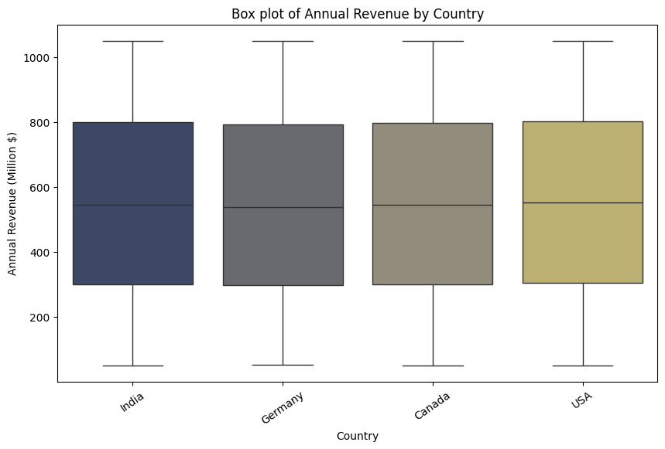
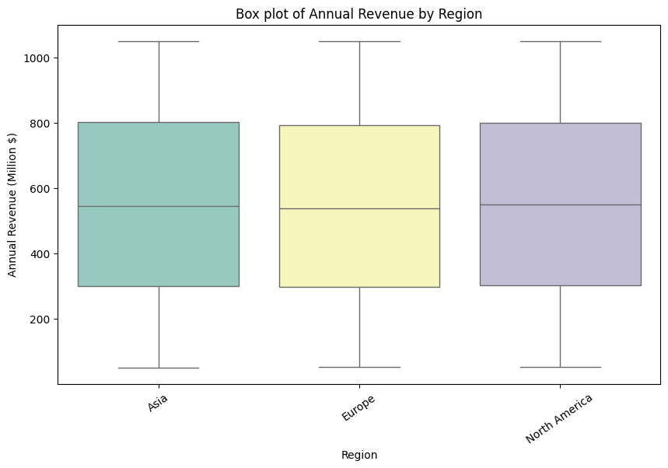
Revenue by Country & Region — Boxplots
Geographic Revenue Analysis: All countries (India, Germany, Canada, USA) and regions (Asia, Europe, North America) show comparable median revenue ~$543.24M with similar IQR ranges

Slide 15
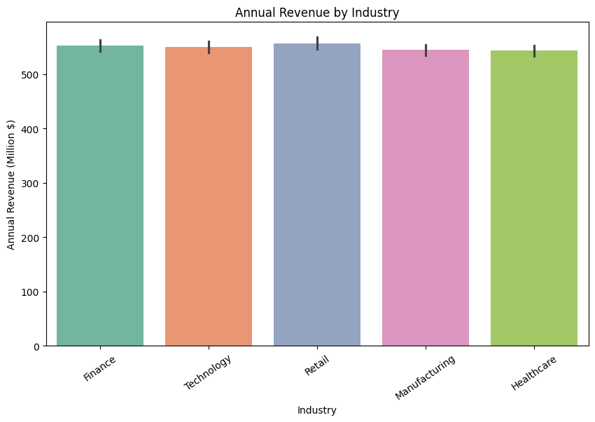
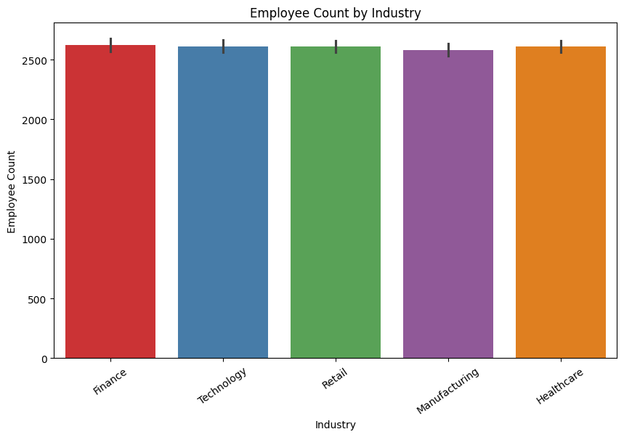
Average Revenue & Employees by Industry
Average metrics are nearly identical across all 5 industries — avg revenue ~$555M and avg employees ~2,600 per industry, confirming balanced dataset distribution

Slide 16
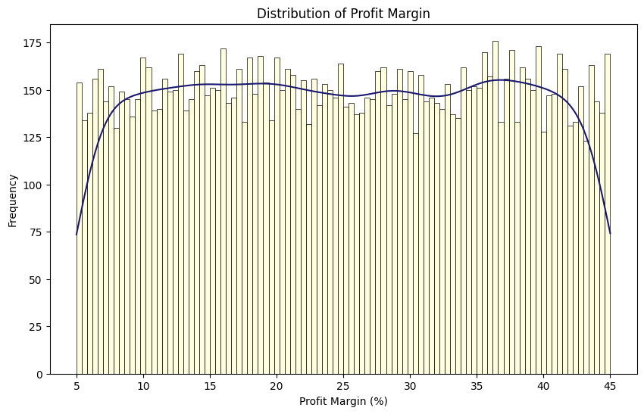
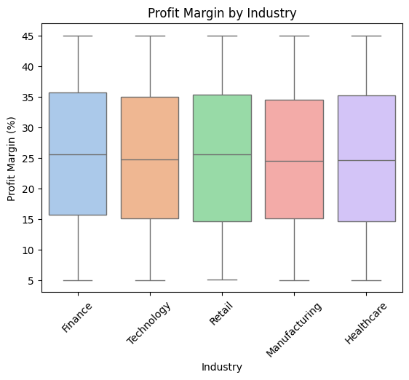
Profit Margin Analysis — Distribution & by Industry
Profit Margin: Range 5%–45% | Mean 24.88% | Relatively stable across industries | All industries have similar profit margin spread

Slide 17
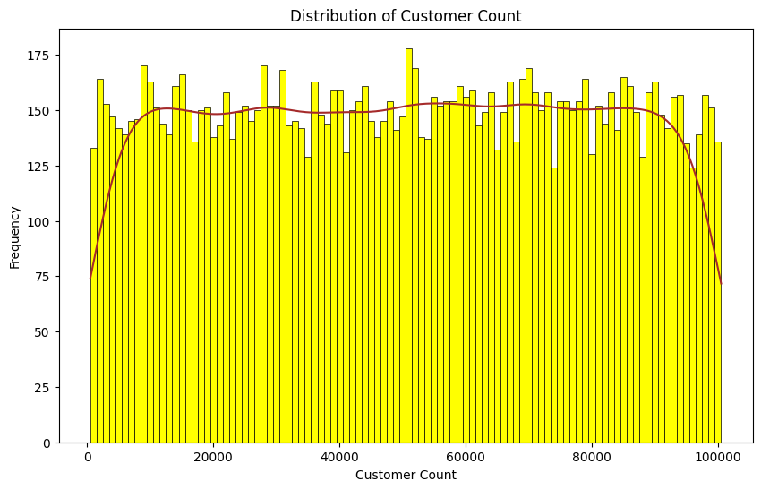
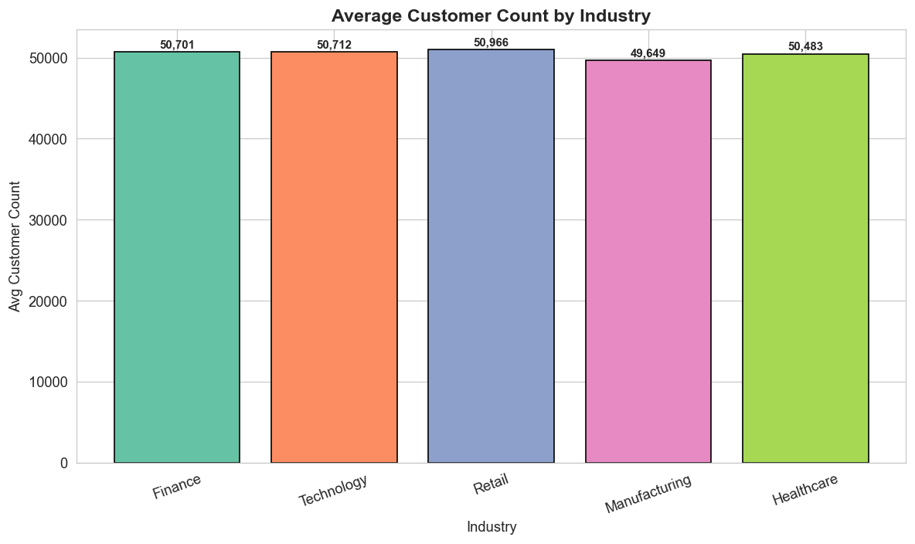
Customer Count Analysis — Distribution & by Industry
Customer Count: Range 502–100,484 | Mean 50,502 | Uniform distribution | Avg ~50,500 customers per industry | Retail and Technology sectors handle larger customer bases

Slide 18
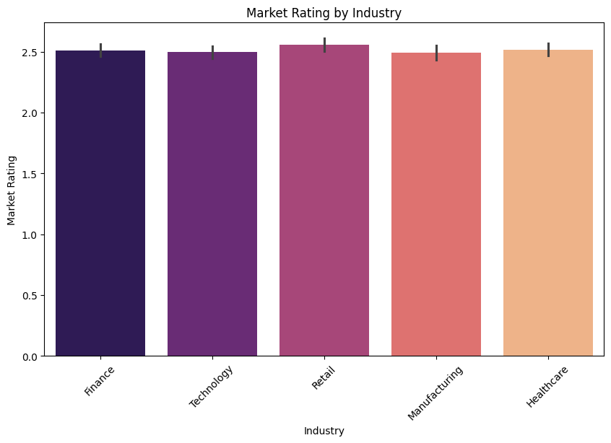
Market Rating by Industry — Bar Plot
Average Market Rating by Industry:
• Finance: ~2.5
• Technology: ~2.5
• Retail: ~2.6
• Manufacturing: ~2.5
• Healthcare: ~2.5
Key Finding:
• Market ratings are nearly identical
across all industries (~2.5/5)
• Industry type is NOT a major driver
of market rating differences
• Consistent variance across categories
• Mean rating: 2.51 | Median: 2.50

Slide 19
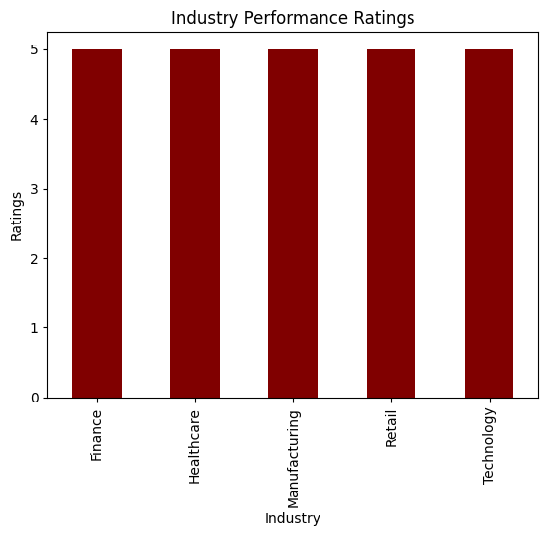
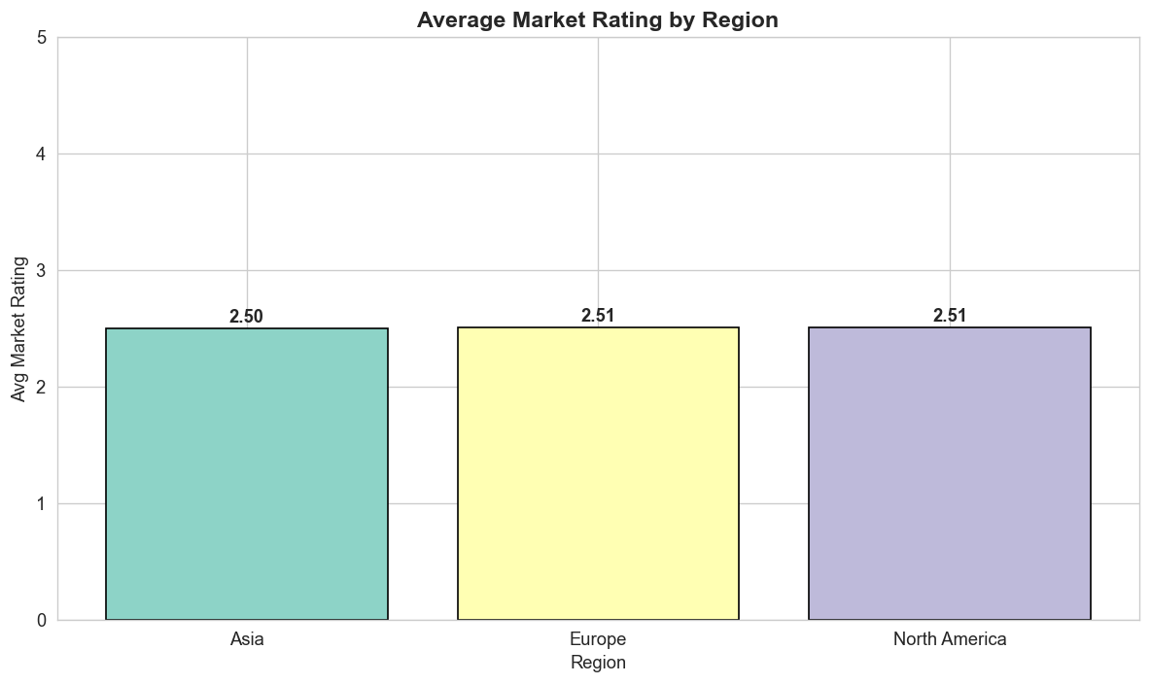
Industry Performance & Regional Ratings
Max market rating reaches 5.0 for all industries | Avg regional ratings: Asia ~2.50, Europe ~2.51, North America ~2.51 — no geographic rating advantage

Slide 20
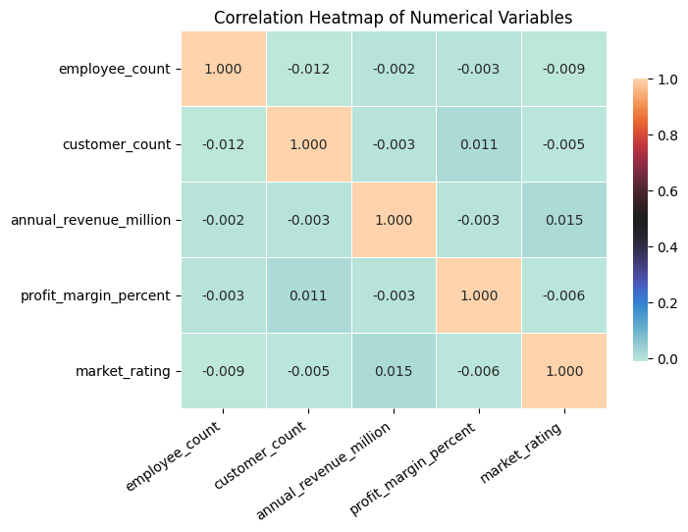
Correlation Heatmap — Numerical Variables
Pearson Correlation Analysis:
• employee_count ↔ revenue: r = -0.002
• customer_count ↔ profit margin per: r = 0.011
• market_rating ↔ revenue: r = 0.015
• employee_count ↔ customer_count: r = - 0.012
Observations:
• All correlations are very weak (|r| < 0.01)
• No strong linear relationships detected
• No multicollinearity issues among variables
• Variables are largely independent
Note: Uniform data distribution results in
near-zero correlations between variables

Slide 21
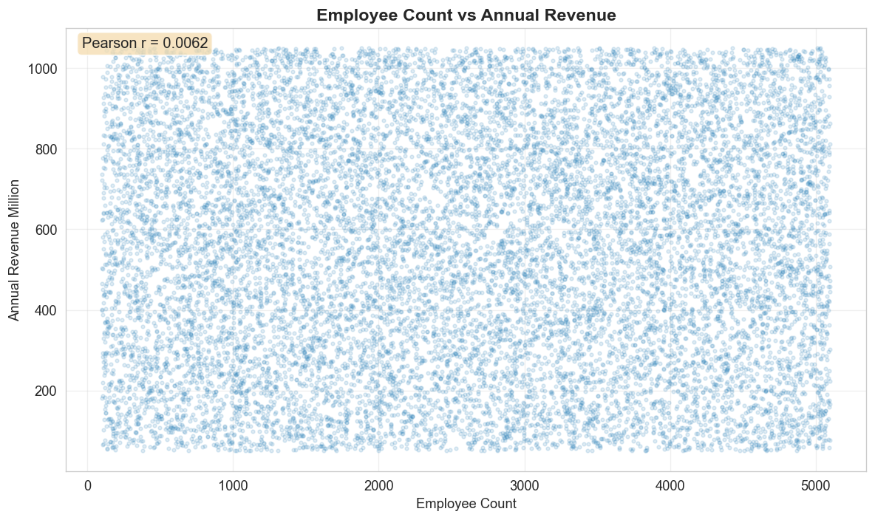
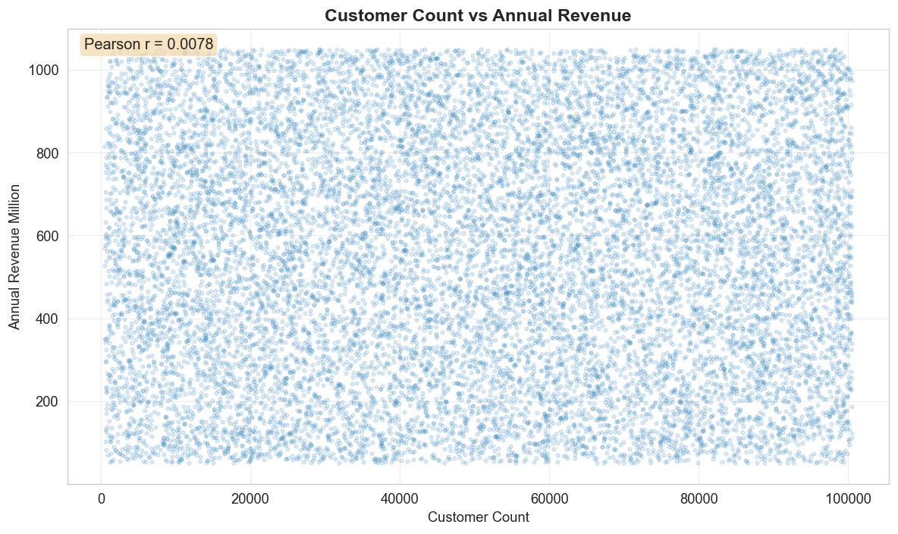
Bivariate Analysis — Revenue Relationships
Employee Count vs Revenue (r=0.006): No clear linear trend — larger workforce does not guarantee higher revenue | Customer Count vs Revenue (r=0.008): Customer base size shows no strong revenue correlation.

Slide 22
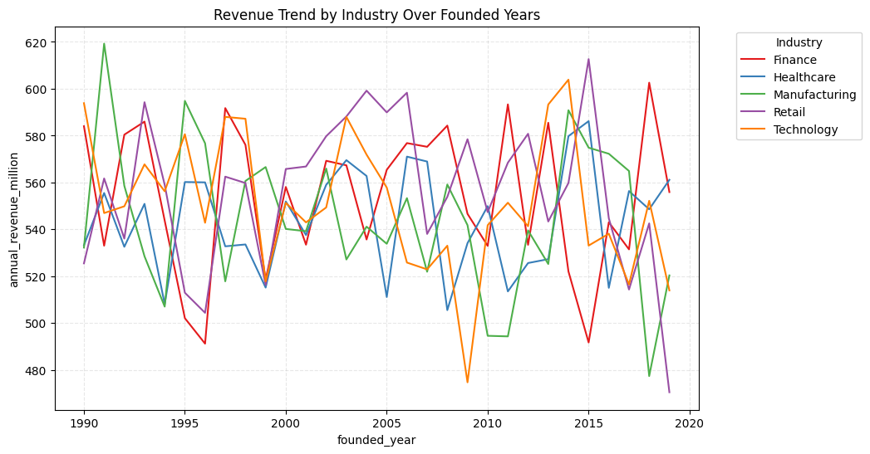
Multivariate Analysis — Industry & Founded Year
None of the five industries shows a consistent upward or downward revenue trend over the 30 years. Revenue fluctuates up and down year by year, staying within a consistent range of approximately $480M to $620M.
Company founded in 1990 is not earning significantly more or less than one founded in 2015. This proves — longevity alone does not translate into financial performance.

Slide 23
Key Statistical Findings
Data Quality:
• 15,000 complete records, 0 nulls, 0 duplicates — fully clean dataset
Distribution Patterns:
• All numerical variables show near-zero skewness (symmetric distributions)
• All variables exhibit negative kurtosis (~-1.19) — platykurtic, fewer outliers
• Revenue, employees, customers uniformly distributed across their ranges
Industry & Geographic Insights:
• 3,000 companies per industry — perfectly balanced sector representation
• 3,750 companies per country — equal geographic distribution
• No single industry or region dominates revenue or ratings
Relationship Analysis:
• Correlations between all variable pairs are very weak (|r| < 0.01)
• No multicollinearity detected — variables are independent
• Market ratings average 2.5/5 consistently across all segments

Slide 24
Conclusion & Business Applications
The analysis confirms a clean, balanced dataset, but weak correlations mean business decisions need deeper segmentation and feature engineering.
Full EDA Insights
▪ Dataset is reliable: 15,000 records, 12 variables, no null values and no duplicate rows.
▪ Revenue is broadly distributed from $50.16M to
$1,049.96M; mean revenue is $549.7M and skew is only 0.0273.
▪ Industry and country samples are balanced;
each industry has 3,000 companies and
each country has 3,750.
▪ Correlations are weak: employee vs revenue
is -0.002 and customer count vs revenue is -0.003.
Business Implications
▪ The dataset is suitable for benchmarking because quality checks passed and segment coverage is even.
▪ Management should not assume revenue is driven only by employee count or customer count.
▪ Retail has the highest average revenue ($562.08M), but gaps are small, so strategy should be segment-specific.
▪ Market rating averages 2.51/5; improvement should target average rating movement, not only top-rated firms.
▪ Next step: engineer features such as company age, revenue per employee, revenue per customer and profit bands before modeling.

